Slide 1

DATA CORRECTION
ECU-ITAI-1-04

Slide 2

1st Learning Outcome
Identifying the differences between different file extensions and formats

Slide 3
Jupyter Notebook
Jupyter Notebook is an open-source web application that allows you to create and share documents that contain live code, equations, visualizations, and narrative text. It was originally developed for the Python programming language but now supports over 40 different programming languages, including R, Julia, and Scala.
In Jupyter Notebook, you work with “notebooks”, which are interactive documents that contain a mix of code cells and markdown cells. Code cells allow you to write and execute code in the notebook, while markdown cells allow you to write formatted text, including headings, lists, and images. You can also include mathematical equations using LaTeX syntax.

Slide 4

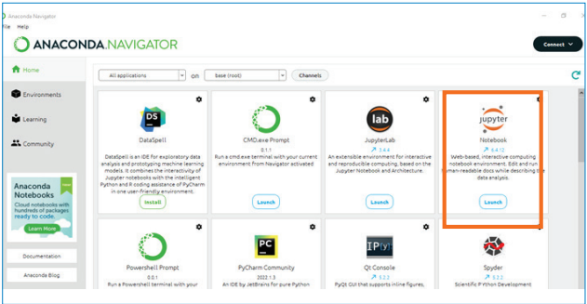
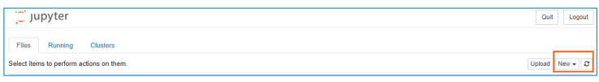
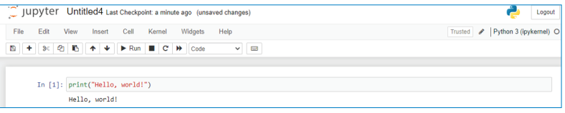
Installing Jupyter Notebook
1. Installing Anaconda Distribution:
2. Opening Anaconda Navigator:
3. Creating a new notebook:
4. Writing code:
5. Saving your notebook:

Slide 5
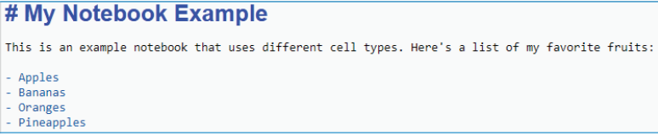
Jupyter Notebook Cells
1. Code cells:
Code cells are used to write and execute code. To create a code cell, click the “+” button in
the toolbar and select “Code” from the dropdown menu. You can then write Python, R, or any
other programming language code in the cell and execute it by pressing “Shift+Enter” or clicking
the “Run” button in the toolbar
2. Markdown cells:
Markdown cells are used to write formatted text and documentation. To create a Markdown
cell, click the “+” button in the toolbar and select “Markdown” from the dropdown menu. You can
then write text using Markdown syntax, which allows you to add headings, lists, links, images,
and other formatting options.

Slide 6
Installing packages in Jupyter Notebook
Type the following command in the code cell to install the package you want:
!pip install <package-name>
Replace <package-name> with the name of the package you want to install.
For example, if you want to install the numpy package, you would type:
!pip install numpy
You should see some output in the code cell indicating that the package was successfully installed

Slide 7
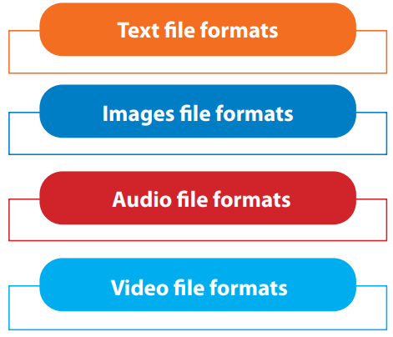
File Extension
In a computer, a file extension, also called a file format, is the layout of a file - in terms of how the data within the file is organized.
Why Are File Extensions Used?
File extensions are designed to store specific types of information. The file format also tells the computer how to display or process its content. Common file formats include CSV, XLSX, ZIP,
TXT, etc.

Slide 8
1. Text
There are several formats and extensions for text files. There are several text file formats, such as, but not limited to, CSV, XLSX, TXT, HTML, and PDF.
Comma-Separated Values (.CSV)
A comma-separated values file is a text file with a specific format that allows data to be saved in a table-structured format.
Here is an example of a simple CSV file:
Name, Age, Gender:
Alice,25,Female
Bob,30,Male
In this example, there are three columns: “Name”, “Age”, and “Gender”. The first row contains the column headers, and the following rows contain the data for each row in the table.CSV is a very simple format and is widely used in data exchange and storage.

Slide 9
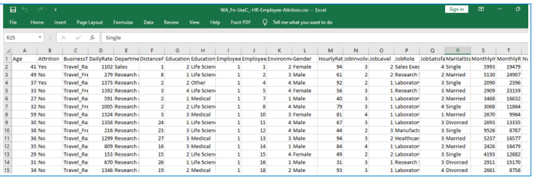
Open a CSV File
a) Microsoft Excel:
The CSV file can be opened by Microsoft Excel Program. To do that, right-click the required file then click “Open with” and then select Microsoft Excel Program.

Slide 10
b) Python Code:
A CSV file can also be opened by Python code. This way enables the developer to perform several programmatic features on the CSV file.
The Pandas library needs to be imported to read CSV files using Python.
Pandas is an open-source Python library for data manipulation and analysis. Pandas contains data structures and processes for manipulating various forms of data.

Slide 11
Pandas Package:
Pandas is a large library with many functions and methods for data manipulation and analysis.
Pandas is built on top of the NumPy library and is designed to work with tabular or labeled data. It introduces two new data structures: Series and DataFrame.
A Series is a one-dimensional array-like object that can hold any data type, such as integers, strings, or even Python objects.
Series can only contain a single list with an index.
A DataFrame is a two-dimensional table-like data structure that contains an ordered collection of columns, each of which can be a different data type (e.g., numeric, string, or boolean). It also has an index, which represents the row labels.
a Dataframe is a collection of series that can be used to analyze the data.

Slide 12
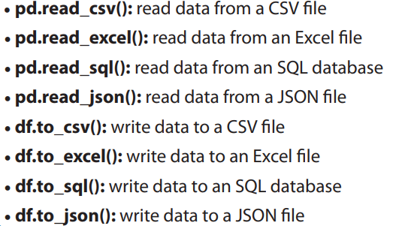
Data input/output functions

Slide 13
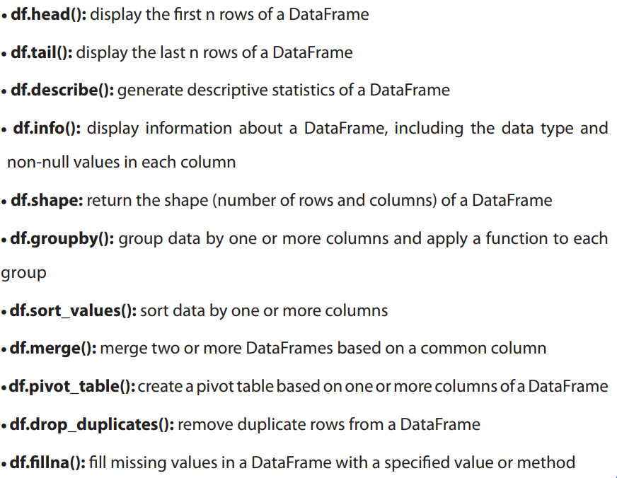
Data manipulation functions:

Slide 14
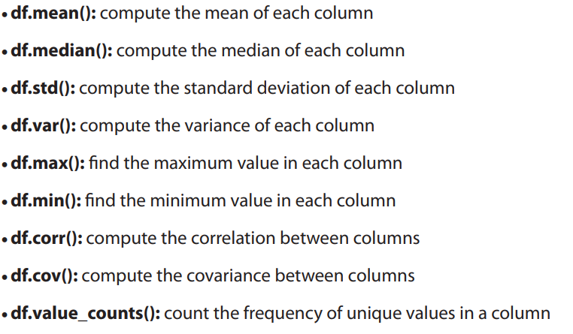
Data analysis functions:

Slide 15
Microsoft Excel Open XLSX Spreadsheet (.XLSX)
Open an XLSX File
a) Microsoft Excel:
The XLSX file can be opened by the Microsoft Excel Program. To do that, right-click the required file, them click “Open with” and then select the Microsoft Excel Program.
b) Python Code:
The XLSX file can also be opened by Python code. This way enables the developer to perform several programmatic features on the XLSX file. To read the XLSX file using Python code.
Use read_excel () from the Pandas library to read the file in the form of a DataFrame by giving it the file path as an argument,

Slide 16
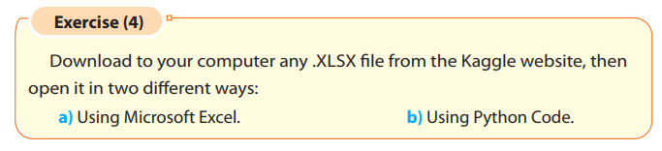
Then convert XLSX to CSV file and open it with python code.

Slide 17
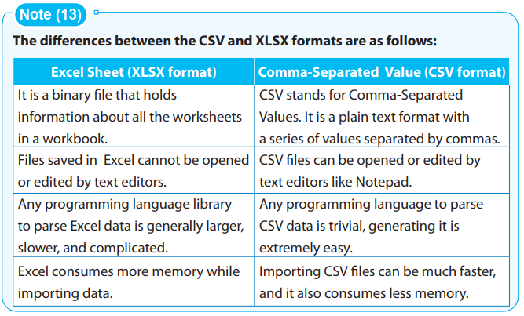

Slide 18
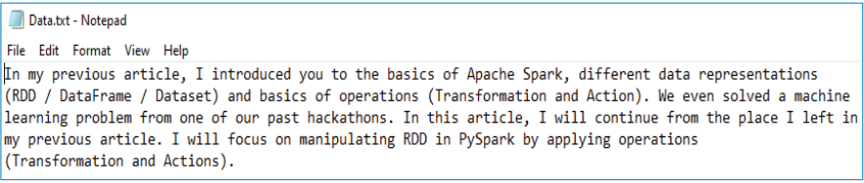
Text File (.TXT)
A text file is a type of digital, non-executable file that contains letters, numbers, symbols, and/or a combination. It enables the creation and storage of text without any special formatting.
Text files are also known as flat files or ASCII files. They are useful for storing information in plain text with no special formatting.
Open a TXT file
a) Notepad:
The TXT file can be opened with Notepad Program. To do that, right-click the required file, click "Open" and then select “Notepad Program”.

Slide 19
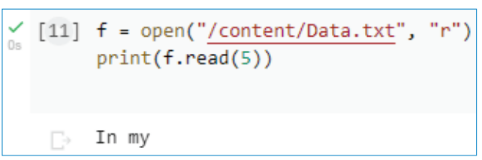
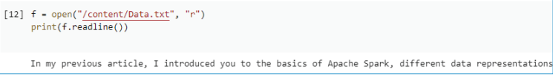
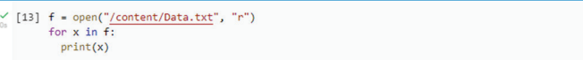
b) Python Code:
to open the file, use the built-in open() function.
By default, the read () method returns the whole text, specify how many characters are needed to return.
Return one line by using the readline () method
By looping through the lines of the file, you can read the whole file, line by line

Slide 20
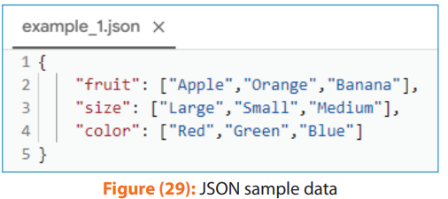
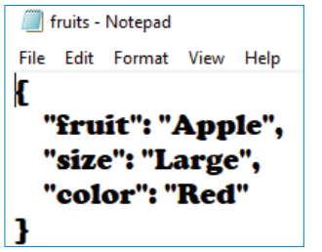
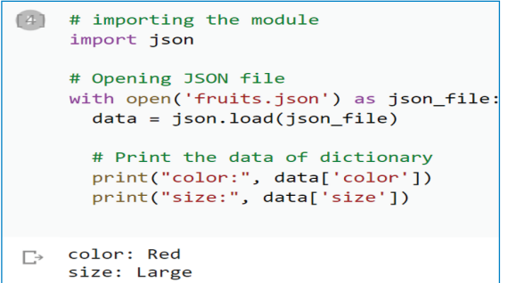
JavaScript Object Notation (.JSON)
Open a JSON File
a) Notepad:
The JSON file can be opened by the Notepad Program. To do that, right-click the required file, click "Open" and then select “Notepad Program”.
b) Python Code:

Slide 21
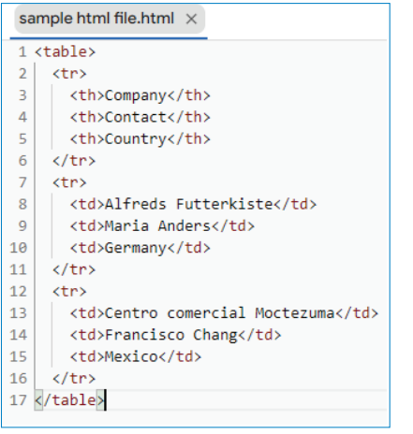
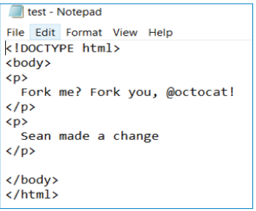
HyperText Markup Language (.HTML)
HyperText Markup Language, or HTML, is a markup language used to describe the structure of information on a webpage.
Open an HTML File
a) Notepad:
The HTML file can be opened by the Notepad Program. To do that, right-click the required file, click “open with” and then select “Notepad Program”.

Slide 22
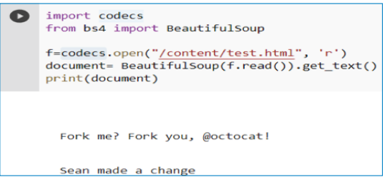
b) Python Code:
- Using the codecs library, the HTML file can be opened using open() function and read it using read() function.
- Then the BeautifulSoup library can be used to extract and display the text from the html format using get_text() function.

Slide 23
BeautifulSoup Package:
BeautifulSoup is a Python package for parsing HTML and XML documents. It is used for web scraping, data extraction, and other tasks where data is extracted from HTML and XML files. It allows you to parse HTML and XML files and provides a way to navigate, search, and modify the parse tree.
To use BeautifulSoup in your Python project, you can install it using !pip install beautifulsoup
BeautifulSoup Package Functionalities:
Parsing functions:
Searching functions:
Tag functions:
Filter functions:
Modification functions:

Slide 24
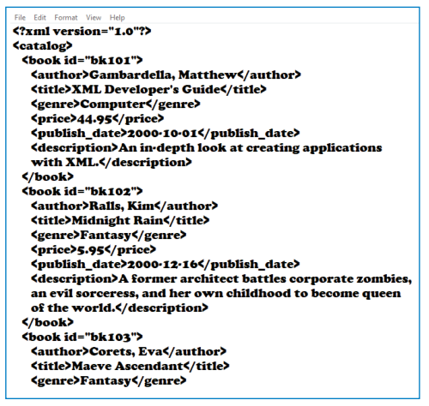
Extensible Markup Language (.XML)
Open an XML File
a) Notepad:
b) Using Programming
Three libraries that are utilized for XML parsing, and will be discussed in this outcome are:
- BeautifulSoup library.
- lxml XML parser.
- Elementtree library.
To read an XML file, the following main steps need to be done:
1. Finding tags.
2. Extracting from tags.

Slide 25
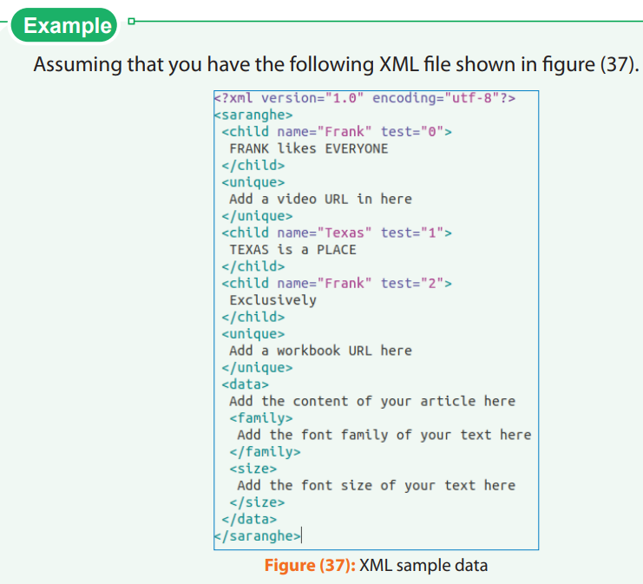

Slide 26
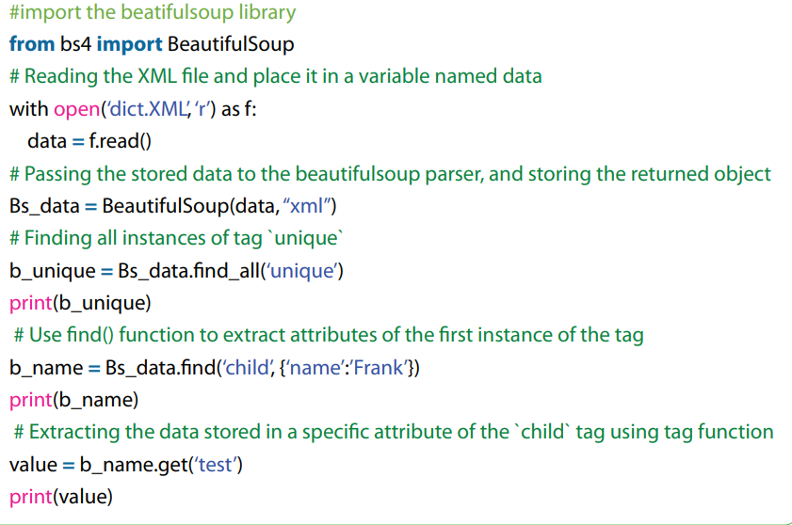
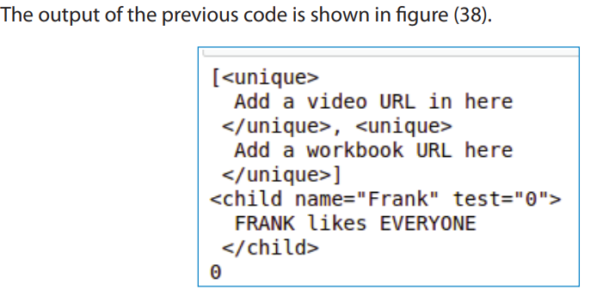

Slide 27
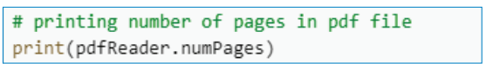
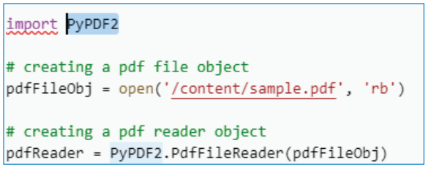
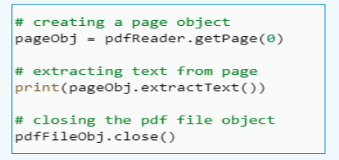
Portable Document Format (.PDF)
Open a PDF file
a) PDF reader:
The PDF file can be opened by the PDF reader program, for example (Adobe Acrobat DC) is a good and free software used to read and edit PDF files
b) Python Code:
You need to install a package named “PyPDF2” that can handle PDF files.
!pip install PyPDF2

Slide 28
String Manipulation
String manipulation is the process of manipulating or modifying strings, which are sequences of characters, to achieve a desired output or result. In Python, string manipulation is a common task that is often used to perform text processing, data cleaning, and other tasks involving textual data.
Python provides a wide range of built-in string manipulation functions and methods that allow you to perform various string operations. As shown in table (1), page no 40,41,42,43 and 44.

Slide 29
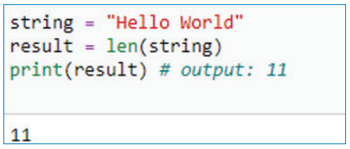
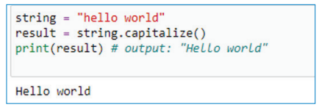
The most common functions of string manipulation in Python.
1. len(): It returns the length of a string.
2. capitalize(): It converts the first character of a string to uppercase and the rest to lowercase.

Slide 30
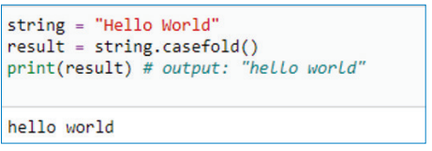
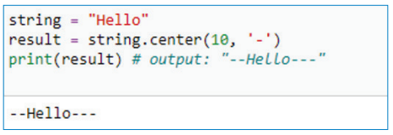
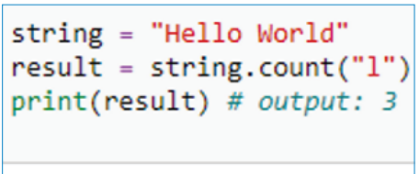
3. casefold(): It converts a string to lowercase and removes all case distinctions in the string.
4. center(): It returns a centered string padded with a specified character where the first
parameter is the max length and the second is the required padding character.
5. count(): It returns the number of occurrences of a specified substring in a string.

Slide 31
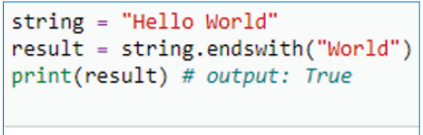
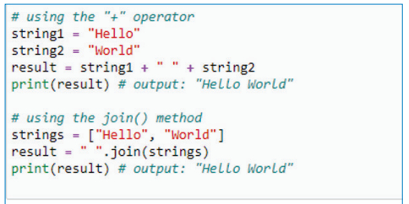
6. endswith(): It returns True if a string ends with a specified suffix, otherwise False.
7. Concatenation: To join two or more strings together, you can use the “+” operator or the join() method.

Slide 32
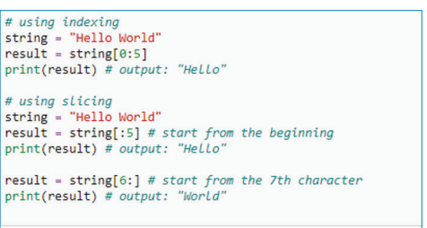
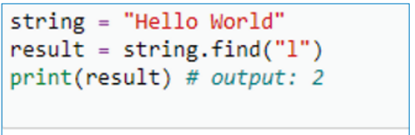
8. Substring Extraction: To extract a portion of a string, you can use indexing and slicing.
Indexing starts at 0 and goes up to the length of the string minus one. Slicing is done using
a colon (:).
9. find(): It returns the index of the first occurrence of a specified substring in a string, or -1 if not found.

Slide 33
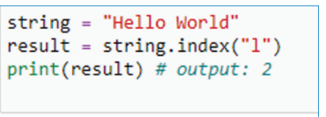
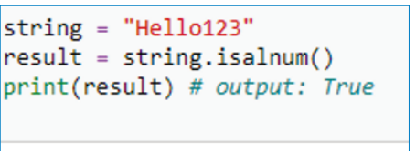
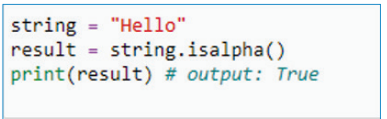
10. index(): It returns the index of the first occurrence of a specified substring in a string, or raises an exception if not found.
11. isalnum(): It returns True if all characters in a string are alphanumeric, otherwise False.
12. isalpha(): It returns True if all characters in a string are alphabetic, otherwise False.

Slide 34
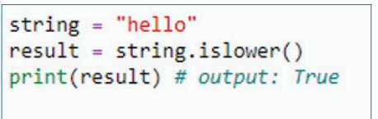
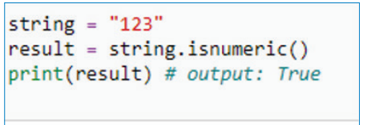
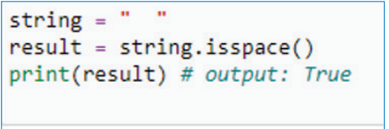
13. islower(): It returns True if all characters in a string are lowercase, otherwise False.
14. isnumeric(): It returns True if all characters in a string are numeric, otherwise False.
15. isspace(): It returns True if all characters in a string are whitespace, otherwise False.

Slide 35
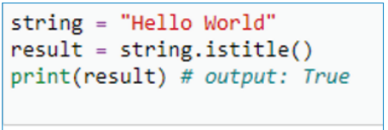
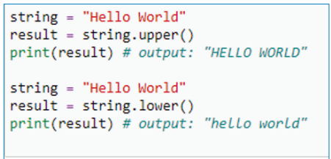
16. istitle(): It returns True if the string is in title case (the first character of each word is uppercase), otherwise False.
17. Case Conversion: To convert the case of a string, you can use the upper() or lower() method.

Slide 36
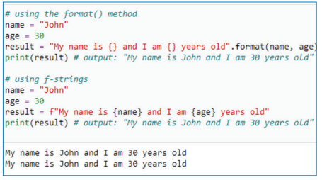
18. String Formatting: To format a string, you can use the format() method or f-strings.
Solve Examples Page no 49 and 50

Slide 37
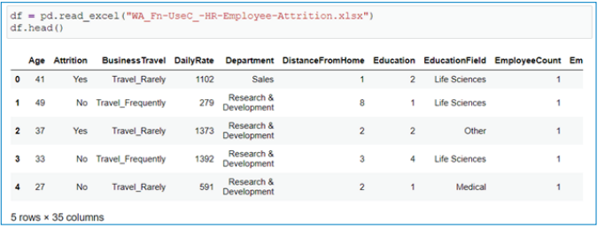
Converting Text Files from One Format to Another
1. From CSV to Excel and Vice Versa:
we use the read_csv () function to read the file, then we use to_excel() to save the file in the given path.
To convert Excel to CSV, use the same code except read the file using read_excel () and use to_csv () instead of to_excel ().

Slide 38
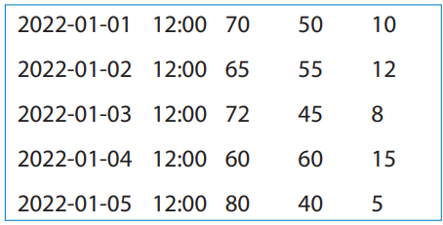
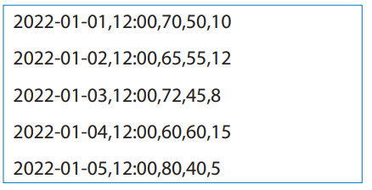
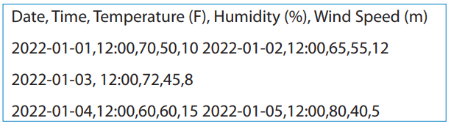
2. From TXT to CSV:
There are two main ways to convert Text files to CSV, which are manual and by Python code.
a) Manual Conversion of Text Files to CSV:
Open the text file in a text editor or spreadsheet program such as Microsoft Excel or Google Sheets.
Identify the delimiter used in the text file to separate each value. This could be a comma, tab, semicolon, or any other character. In our example, the delimiter is a tab.
Replace the delimiter in the text file with a comma, which is the standard delimiter used in CSV files.
. Add a header row to the file, which should contain the names of each column.
Save the file with a .csv file extension.

Slide 39

b) Programatic Conversion of a Text File to a CSV File:
Import the csv module:
Open the text file:
Open the CSV file:
Create a CSV writer object:
Loop through the text file
Close the files:

Slide 40

3. From CSV to Txt:
To convert CSV file to TXT file, we will go through the main steps as in the conversion from TXT to CSV with some modifications.
Open the CSV file.
Identify the delimiter used in the CSV file to separate each value.
Replace the delimiter in the CSV file with another to make the TXT file.
Save the file with a .txt file extension.
In Python, perform the following steps:
Open the CSV file:
Open the text file:
Create a CSV reader object:
Loop through the CSV file:
Close the files:

Slide 41



4. From JSON to TXT:
First, why is JSON important?
The majority of APIs return data either in JSON or in XML. JSON is much simpler to work with, at least in Python.
Use the Pandas read_json () function to read the file “File.json”.
Then use Pandas to_csv () to convert the file to txt “New File.txt”
This is the output TXT file
This is the input JSON file

Slide 42
5. From HTML to TXT:
Why is HTML important?
Most data analysts need to communicate their findings to clients, other departments, or company stakeholders. CSS and HTML can help analysts create pleasing online platforms that host their data-filled visual representations.
The BeautifulSoup library will be used to convert HTML content to normal text.
1. Install the BeautifulSoup library by! pip install beautifulsoup4 command.
2. Import the BeautifulSoup library.
3. Open the file using the open() function.
4. Read the file using the read() function.
5. The BeautifulSoup library will be used to run and extract text from an HTML file and
splay using the get_text() function.
6. Then write this text to a TXT file like, previously done in figure (60), using the file. write(
function.

Slide 43



Slide 44

Solve this is Exercise

Slide 45

Transforming XML to other formats
we will cover a complete example of transforming a JSON file to XML.
To construct an XML file from a JSON file, you need to perform the following steps:
1. Collect the Data:
To construct a JSON file, we must first collect the necessary information.

Slide 46


2. Access/Construct a JSON File:
Save this document as “employee
json file.json.”
3. Construct an XML File:
a) Read a JSON file

Slide 47
b) Consruct an XML file
The XML library xml.etree.cElementTree will now be imported.
we will now build the root of the XML file because every XML file needs one in our example, the root will be stored in a varibale r and the root has a name “Employee”.
To add the details of the employee, we will create SubElements of root for our XML Documents and fill it with corresponding data.
Build an XML Tree.
Finally, create an XML file and write our XML tree to the file.

Slide 48


The whole problem solution
Json_to_xml.xml file content

Slide 49

2. Image
Image files are probably the most fascinating file format used in data science. All computer vision applications are based on image processing. So, it is necessary to know different images and how to deal with them.Most images are 3-Dimensional, having RGB (Red-Green-Blue) values
The distinction between RGB and BGR

Slide 50
Common Image Format:
a) TIFF (.tif, .tiff)
TIFF which stands for (Tagged Image File Format) does not need to be compressed or lose any image quality or information, allowing for very high-quality images but they are larger in size.
1. Compression: no need for compression. Very high-quality images.
2. Best for high-quality prints, and professional publications.
3. Special attributes: it can be transparent.
b) JPEG (.jpg, .jpeg)
JPEG which stands for (Joint Photographic Experts Groups) is compressed to make a smaller file which causes a loss in quality (not very noticeable). JPEG files are very common and they are a popular format for digital cameras - making it ideal for web use and non-professional prints.
1. Compression: some file information is compressed or lost.
2. Best for web images, non-professional printing, email, and PowerPoint.
3. Special attributes: the amount of compression can be chosen when saving in image
editing programs like Adobe Photoshop or GIMP.

Slide 51
c) GIF (.gif)
GIF stands for (Graphics Interchange Format) files are typically small and very portable. They are used for web graphics, because they are limited to only 256 colors, can allow for transparency, and can be animated.
1. Compression: compression without loss of quality.
2. Best for web images.
3. Special attributes: it can be animated. It can be transparent.
d) PNG (.png)
PNG which stands for (Portable Network Graphics) is a file designed to improve and replace the GIF format. PNG files can handle up to 16 million colors, unlike the 256 colors supported by GIF.
1. Compression: compression without loss of quality is best for web images.
2. Special attributes: it can be transparent.
Image Formats Comparison: Page no 69

Slide 52

Image Characteristics:
Before dealing with images, we need to get familiar with some fundamental concepts of images.
Digital Image Processing (DIP) is the manipulation and analysis of digital images using computer
algorithms. Here are some basic concepts related to DIP:
a) Color systems:
In digital images, colors are represented using different color systems. The most common
ones are RGB (Red-Green-Blue), CMYK (Cyan-Magenta-Yellow-Key/Black),
and HSV (Hue-Saturation-Value).
RGB is used for displaying images on a screen, while CMYK is used for printing
b) Pixels:
The smallest unit of an image is called a pixel, short for picture element. A pixel represents
a single point in the image and contains information about its color and brightness.
The number of pixels in an image determines its resolution.

Slide 53

c) Arrays:
A digital image can be thought of as a 2D array of pixels. Each pixel is represented by a value
or set of values, depending on the color system used. The array is often stored in a file format,
such as JPEG or PNG.
d) Image acquisition:
This involves capturing an image using a digital camera, scanner, or another device. It
includes techniques for correcting distortions, removing noise, and adjusting exposure.
e) Image enhancement:
This involves improving the quality of an image by applying various techniques such as
contrast enhancement, noise reduction.

Slide 54

f) Image filtering:
Image filtering is a technique used to modify the appearance of an image. Filters can be used
to smooth the image, enhance certain features, or remove noise.
g) Image compression:
This involves reducing the size of an image file without significantly affecting its quality. It is
used to save storage space and reduce transmission time in applications such as video streaming
and satellite imaging.
h) Image restoration:
This involves restoring an image that has been degraded due to various factors such as
motion blur, noise, or incomplete data.

Slide 55


i) Edge detection:
Edge detection is a fundamental concept in computer vision that involves identifying edges or boundaries in an image, where an edge is defined as a sudden change or discontinuity in
the intensity or color of adjacent pixels. Edge detection is often used as a preprocessing step in many computer vision applications, such as object detection, image segmentation, and feature extraction.
j) Image analysis:
This involves dividing an image into multiple segments, each representing a distinct object or region of interest. It is used in applications such as object recognition and tracking.

Slide 56

l) Object recognition:
This involves identifying objects in an image and recognizing their shapes, sizes, and positions. It is used in applications such as facial recognition and self-driving cars.
m) Morphological processing:
This involves analyzing the shape and structure of objects in an image using mathematical morphology techniques such as erosion, dilation, and opening.
These are just a few basic concepts in digital image processing. DIP is a vast field with many
applications, including medical imaging, remote sensing, and computer vision.

Slide 57


Slide 58
Computer Vision Fundamentals:
Computer vision is an interdisciplinary field that focuses on enabling computers to interpret and understand digital images and videos. In other words, Computer vision is a field that involves enabling computers to interpret and understand visual data from the world around us. The fundamentals of computer vision include concepts from the DIP system and other more advanced concepts like object recognition and detection, scene reconstruction, and many other advanced concepts.
1. Image processing:
This involves techniques for enhancing or manipulating digital images, such as filtering, segmentation, and edge detection.

Slide 59

2. Feature Extraction:
Feature extraction is the process of identifying and extracting important visual patterns or features from an image, which can then be used for various computer vision tasks such as object recognition, classification, and tracking.
3. Object recognition and detection:
This involves identifying and localizing objects within an image or video stream, and may involve techniques such as template matching, feature detection, or machine learning algorithms.
4. Image classification:
This involves categorizing images based on their content. Common techniques for image classification include supervised learning algorithms, such as convolutional neural networks.

Slide 60

5. Tracking:
This involves identifying and tracking the movement of objects within an image or video stream. Techniques for tracking include optical flow and object-tracking algorithms.
6. Scene reconstruction:
This involves creating a 3D model of a scene or object from a series of 2D images or video frames, and may involve techniques such as stereo vision, structure from motion, or depth estimation algorithms.

Slide 61
7. Machine learning and deep learning:
These are techniques that involve training algorithms to automatically learn patterns and features from visual data, and are increasingly being used in many computer vision applications.
8. Augmented reality:
This involves overlaying digital content onto the real world. Computer vision techniques are used to track the position and orientation of a camera in real-time, allowing digital content to be placed and rendered in a realistic way.

Slide 62


Slide 63
How to Deal with Images
1. OpenCV
OpenCV is an open-source library developed by Intel in 2000. It is mostly used in computer vision like object detection, face detection, face recognition, image segmentation, etc.
Code Example:
1. Import the OpenCV library (cv2).
2. Use cv2.imread() to load the image. The imread method takes the path of the image.
3. Use cv2.cvtColor() function with cv2.COLOR_BGR2RGB as an argument to convert the image from BGR (Blue-Green-Red) to RGB (Red-Green-Blue) to display it.
4. Display the image with matplotlib. pyplot library using the imshow () function.

Slide 64


Slide 65

2. Scikit-Image
Scikit-image is a Python-based image processing library that aims to achieve good performance.
Code Example:
1. Import the Skimage library.
2. Use skimage.io.imread() to read the image.
3. Display the image with matplotlib.pyplot library using imshow() function.
Before importing OpenCV, the library using !pip install opencv-Python.needs to be installed.

Slide 66

3. Pillow/PIL
PIL (Python Imaging Library) is an open-source library for image processing tasks that requires Python programming language. PIL can perform tasks on an image such as reading, rescaling, and saving in different image formats.
Code Example:
1. Import an image from the PIL library.
2. Open the image with the Image.open() function.
3. Display the image using the show() method in the returned object from Image.open().

Slide 67

Converting an Image to a Different Format
1. Using the OpenCV () library:
The image format can be converted by just saving the image in the new format. In this example, “Windows.png” to “Windows.jpg” was converted and saved using cv2.imwrite() and the new path as an argument.

Slide 68

2. Using the Pillow Library):
use Images.convert () function to convert the image from BGR (Blue-Green-Red) to RGB (Red-Green-Blue) to display it.Then use the save () function to save the image with the new format.

Slide 69

3. Audio
A computer system can store digital audio data in an audio file format. The audio file usually contains a very large number of bits, which in turn produces very large files. Accordingly, these files can be either uncompressed or compressed to reduce file size. Usually, data compression in audio files results in losing some data. The audio files are classified into compressible and uncompressible file formats.
There are many types of audio files, but these are two of the most common files:
MP3 audio format (lossy compression format).
WAV audio format (uncompressible format).
MPEG-1 Audio Layer 3
MP3 (MPEG-1 Audio Layer 3) is a standard technology and format for compressing a sound
sequence into a very small file (about one-twelfth of the size of the original file)

Slide 70

2. Waveform Audio File Format (WAV)
Waveform Audio File Format (WAV) is an audio file format standard, developed by IBM and Microsoft, for storing a raw audio bitstream on PCs .
It is the main format used on Microsoft Windows systems for uncompressed audio professional music producers use WAV files with their audio editing software. WAV files produce high-quality audio that can easily be edited. WAV format is the uncompressible format.

Slide 71

Comparison between WAV and MP3 audio formats

Slide 72


Reading Audio Files
There are two main ways to read an audio file. The first approach is to use the proper audio player software.
The second approach is the programmatic technique to read audio files.
Python Code for Reading Audio Files
You need to install a package named “Librosa” that can handle audio files.
!pip install librosa
To be able to listen to the read audio in Jupyter notebook or Google Colab, IPython needs to be installed. !pip install IPython

Slide 73

Python Code for Converting Audio Files
Several libraries enable the developer to transform an audio file from one format to another. One
of these libraries is the FFMPEG library. FFMPEG is a free open-source software project consisting of
a large suite of libraries and programs for handling video, audio, and other multimedia files.
The Pydub library also needs to be installed. The Pydub library is an audio manipulation
module. Pydub library is a Python library used to work with only WAV files.
Two packages named “FFMPEG” or “Pydub” need to be installed to transform an audio file from one format to another.
!pip install ffmpeg
!pip install pydub
The installation of ffmpeg has to be using Anaconda prompt. So, you have to install Anaconda software tool. The command is conda install -c conda-forge ffmpeg.

Slide 74
4. Video
There are several video formats with various specifications. Video formats are a sort of file format used
to store digital video data on a computer system. Lossy compression is often used to save the video to minimize file size. A video file typically consists of a container that can contain both audio and visual data in separate audio and video coding formats.
Four of the most common video formats
MP4 video format
MOV video format.
AVI video format.
MKV video format.

Slide 75
MPEG-4 Part 14 (MP4)
An MP 4 is a common “container format” for video files that allows you to store a lot of video and audio information in a smaller file size.
Metal Oxide Varistor (MOV)
An MOV is a video format that was developed by Apple. It’s a MPEG 4 video container file that is primarily used with Apple’s QuickTime program. An MOV video can hold many different video formats and multimedia — audio, video, and text — in the same file on different tracks.
Audio Video Interleave (AVI)
AVI files can contain both audio and video data in a file container that allows synchronous audio?with-video playback. Like the DVD video format, AVI files support multiple streaming audio and video, although these features are seldom used.
Matroska Video (MKV)
MKV videos, are container files that support unlimited picture, audio, and subtitle tracks. They are similar to MOV and AVI files, except they have a much larger amount of storage. They are an all-in-one video format.

Slide 76

Pros & Cons of each one of those formats (MP4 - AVI - MKV):

Slide 77
Reading Video Files
There are two main ways to read a video file. The first approach is to use the proper video player software. The second approach is the programmatic technique to read video files.
Python Code for Reading Video Files
one of the most known libraries for reading video files is OpenCV-Python library can be used to read the video file.
To read the video file, perform the following steps:
Import the OpenCV-Python library by importing the cv2 command
To read the video, specify the path to the video and then use the video capture method from OpenCV The video capture method takes the path of the video as a parameter. Video capture is a method that can read, display, edit, and save videos.
To display the video so that you can watch it, you can read the frames of the video and display it using the imshow() method.

Slide 78




Slide 79

Python Code for Converting Video Files
To convert a video file from one form to another, perform the following steps:
Specify the path of the aimed input file and the name of the output file.
Import the subprocess package of Python.
Call the subprocess responsible for converting the input video file to the output video file

Slide 80
2st Learning Outcome
Dealing with different data formats

